Slide 1
Online Learning for Linear Regression (Forecast)
Shiuli Subhra Ghosh
Suman Roy
Chennai Mathematical Institute

Slide 2
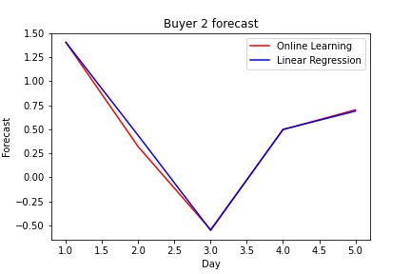
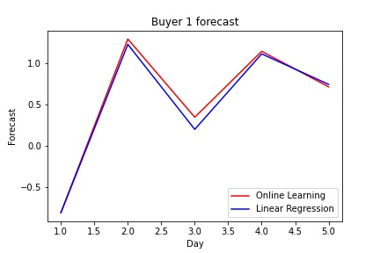
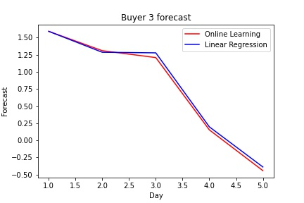
Comparison of Online and Off-line learning

